Slide 1

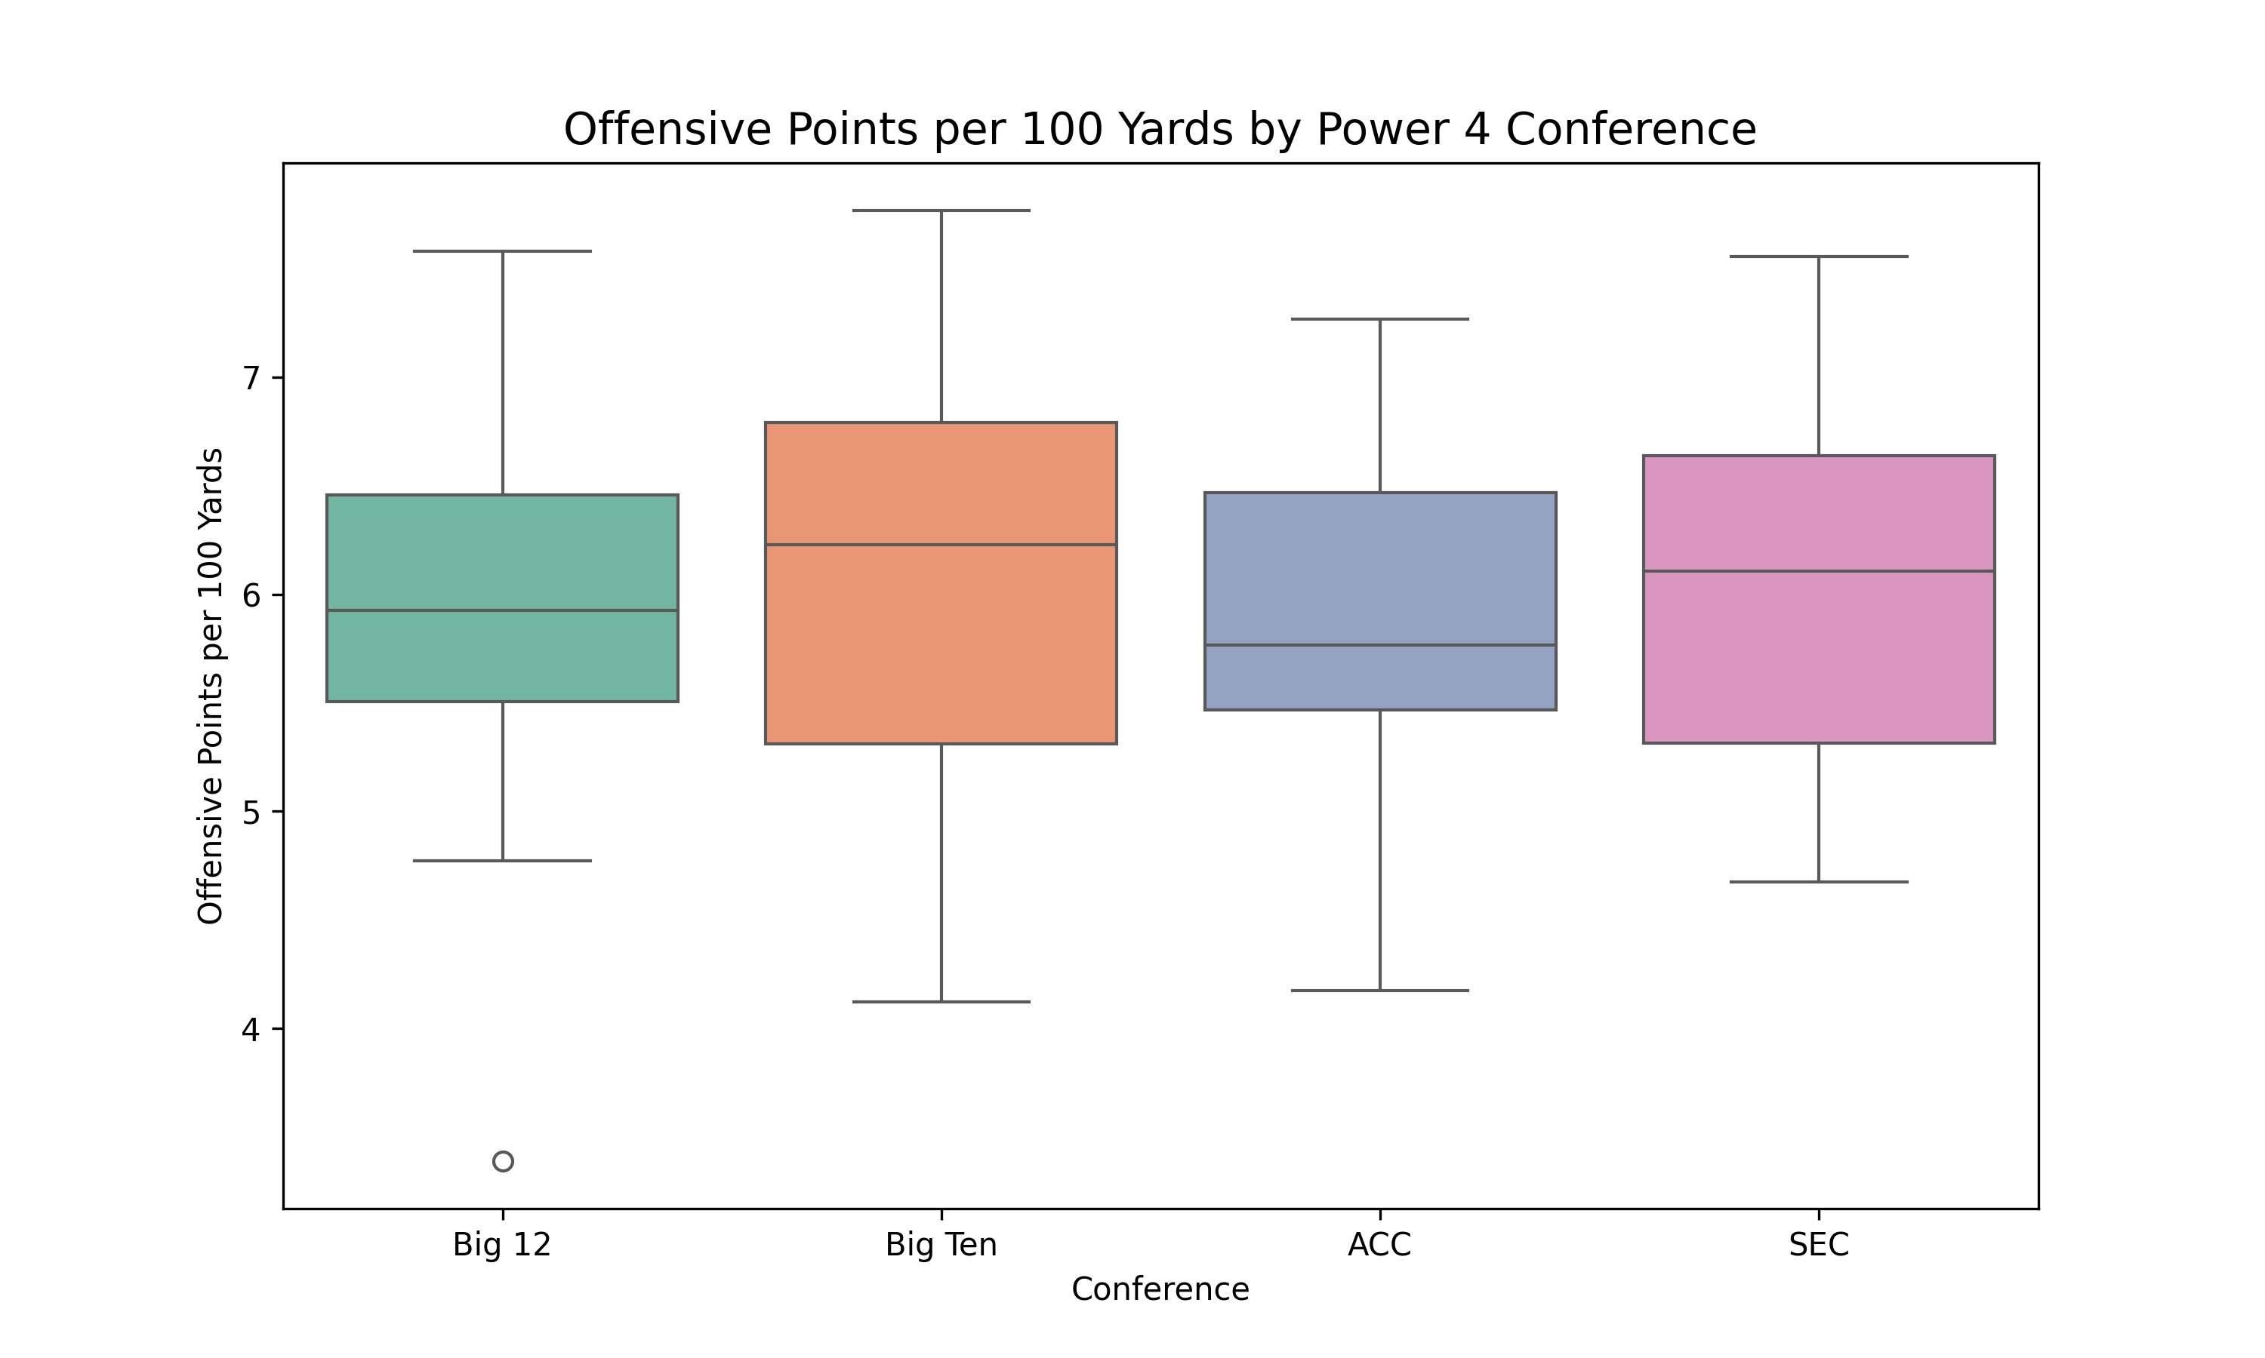
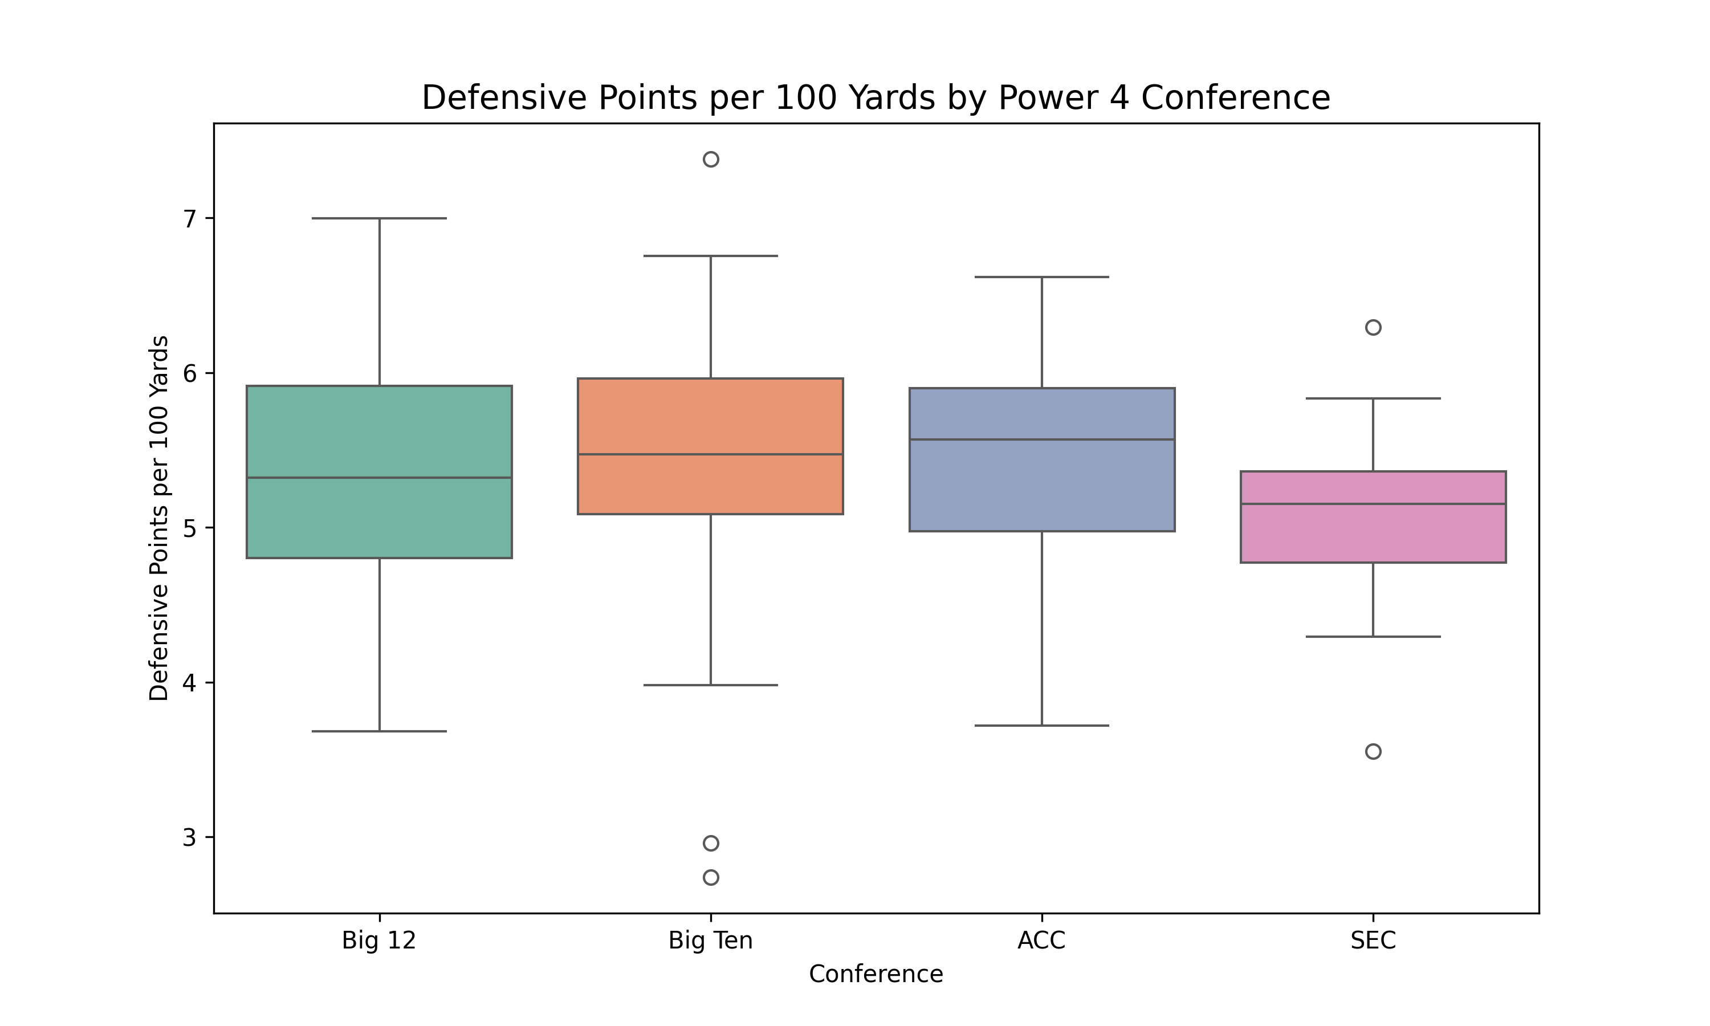
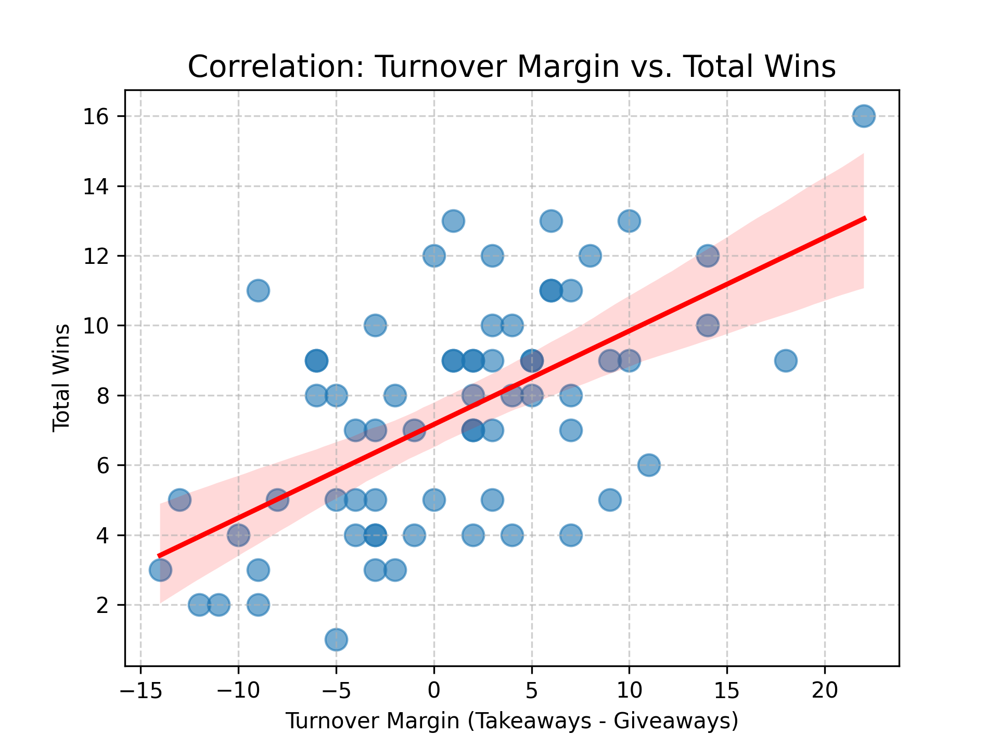
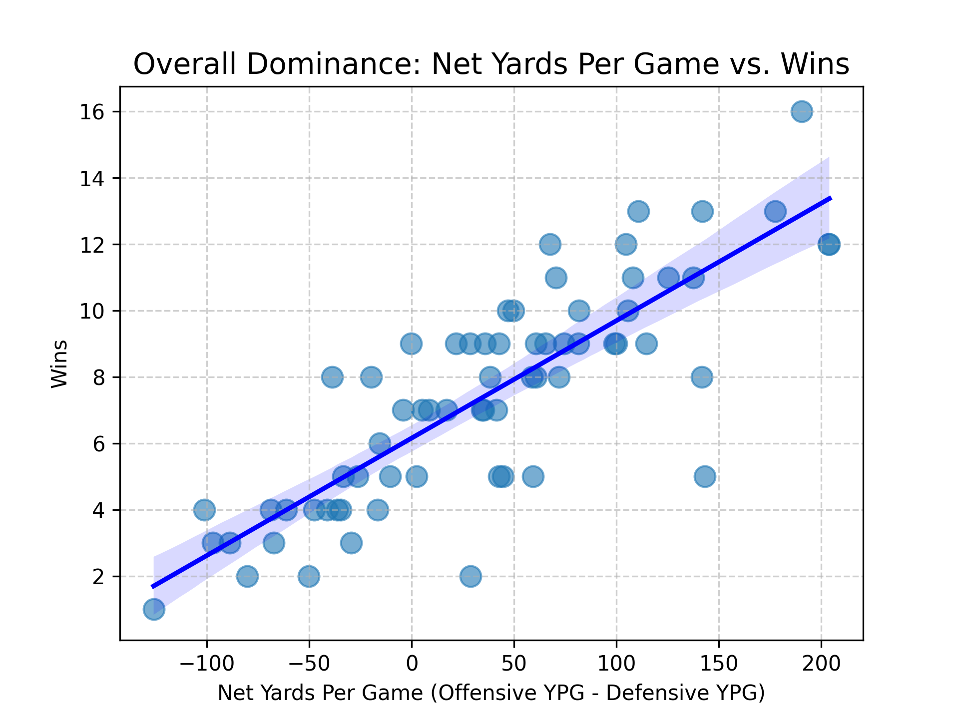
Is Defense or Offense More Important when it come to NCAA Football?
Cael Meacham
Introduction
Results
Conclusions
This project uses Python and the CFB Data API to analyze what drives success in the 2025 Power 4 football season. By examining the ACC, Big 12, Big Ten, and SEC, I investigated whether a high-powered offensive or strong and dependent defensive is the primary predictor of winning. The goal was to determine if "defense wins championships" still holds true or if modern offensive efficiency has shifted the advantage toward high-powered offenses.
The best way to determine the usefulness of turnovers is to compare offensive and defensive turnovers. Turnover margin tells us that the more turnovers you cause than give up, the more wins you get, however, the data also shows that it isn’t the main factor in determining wins as the line doesn’t fit the data perfectly. Turnovers play an impactful role in determining wins, however, it is not the most important. The data tells us that defensive efficiency (points per 100 yards allowed) is the most significant variable when it comes to total wins and offensive efficiency is second. Even though offensive output is often seen most in statistics throughout the game, the analysis shows us that defensive efficiency slope is significantly higher than the offensive efficiency slope, telling us that defensive efficiency is more important when it comes to winning games.
Methodology
I was able to utilize a data science pipeline to retrieve and normalize team statistics and records into Pandas DataFrames. From there, I created key variables including Net Yards Per Game, and Points per 100 Yards to measure situational efficiency beyond raw yardage. Finally, I applied linear regression modeling and conference-specific boxplots to quantify the correlation between these statistical drivers and total win counts.
Resources
GitHub Repository
https://collegefootballdata.com/
https://github.com/Cmeacham27/final_web_mining

Slide 2
Data Collection and Preparation
Collected data from https://collegefootballdata.com/
Pulled data using an API key
Used Json to dump the data for offensive and defensive statistics for every team in the 2025 season into 2 files, raw season stats, and raw records
Data Available: player and teams offensive and defensive statistics as well as box scores, betting lines, coaches, conferences, draft picks, play types, weather, etc.

Slide 3
Processing
The data was extremely clean, so I did not have to go through any steps to clean the data
Variables used: wins, total yards, passing td’s, rushing td’s, games, points, turnovers
Variables created: estimated points, points per 100 yards, yards per game, net yards per game, turnover margin
Created to make more impactful data, eliminate outlying games

Slide 4
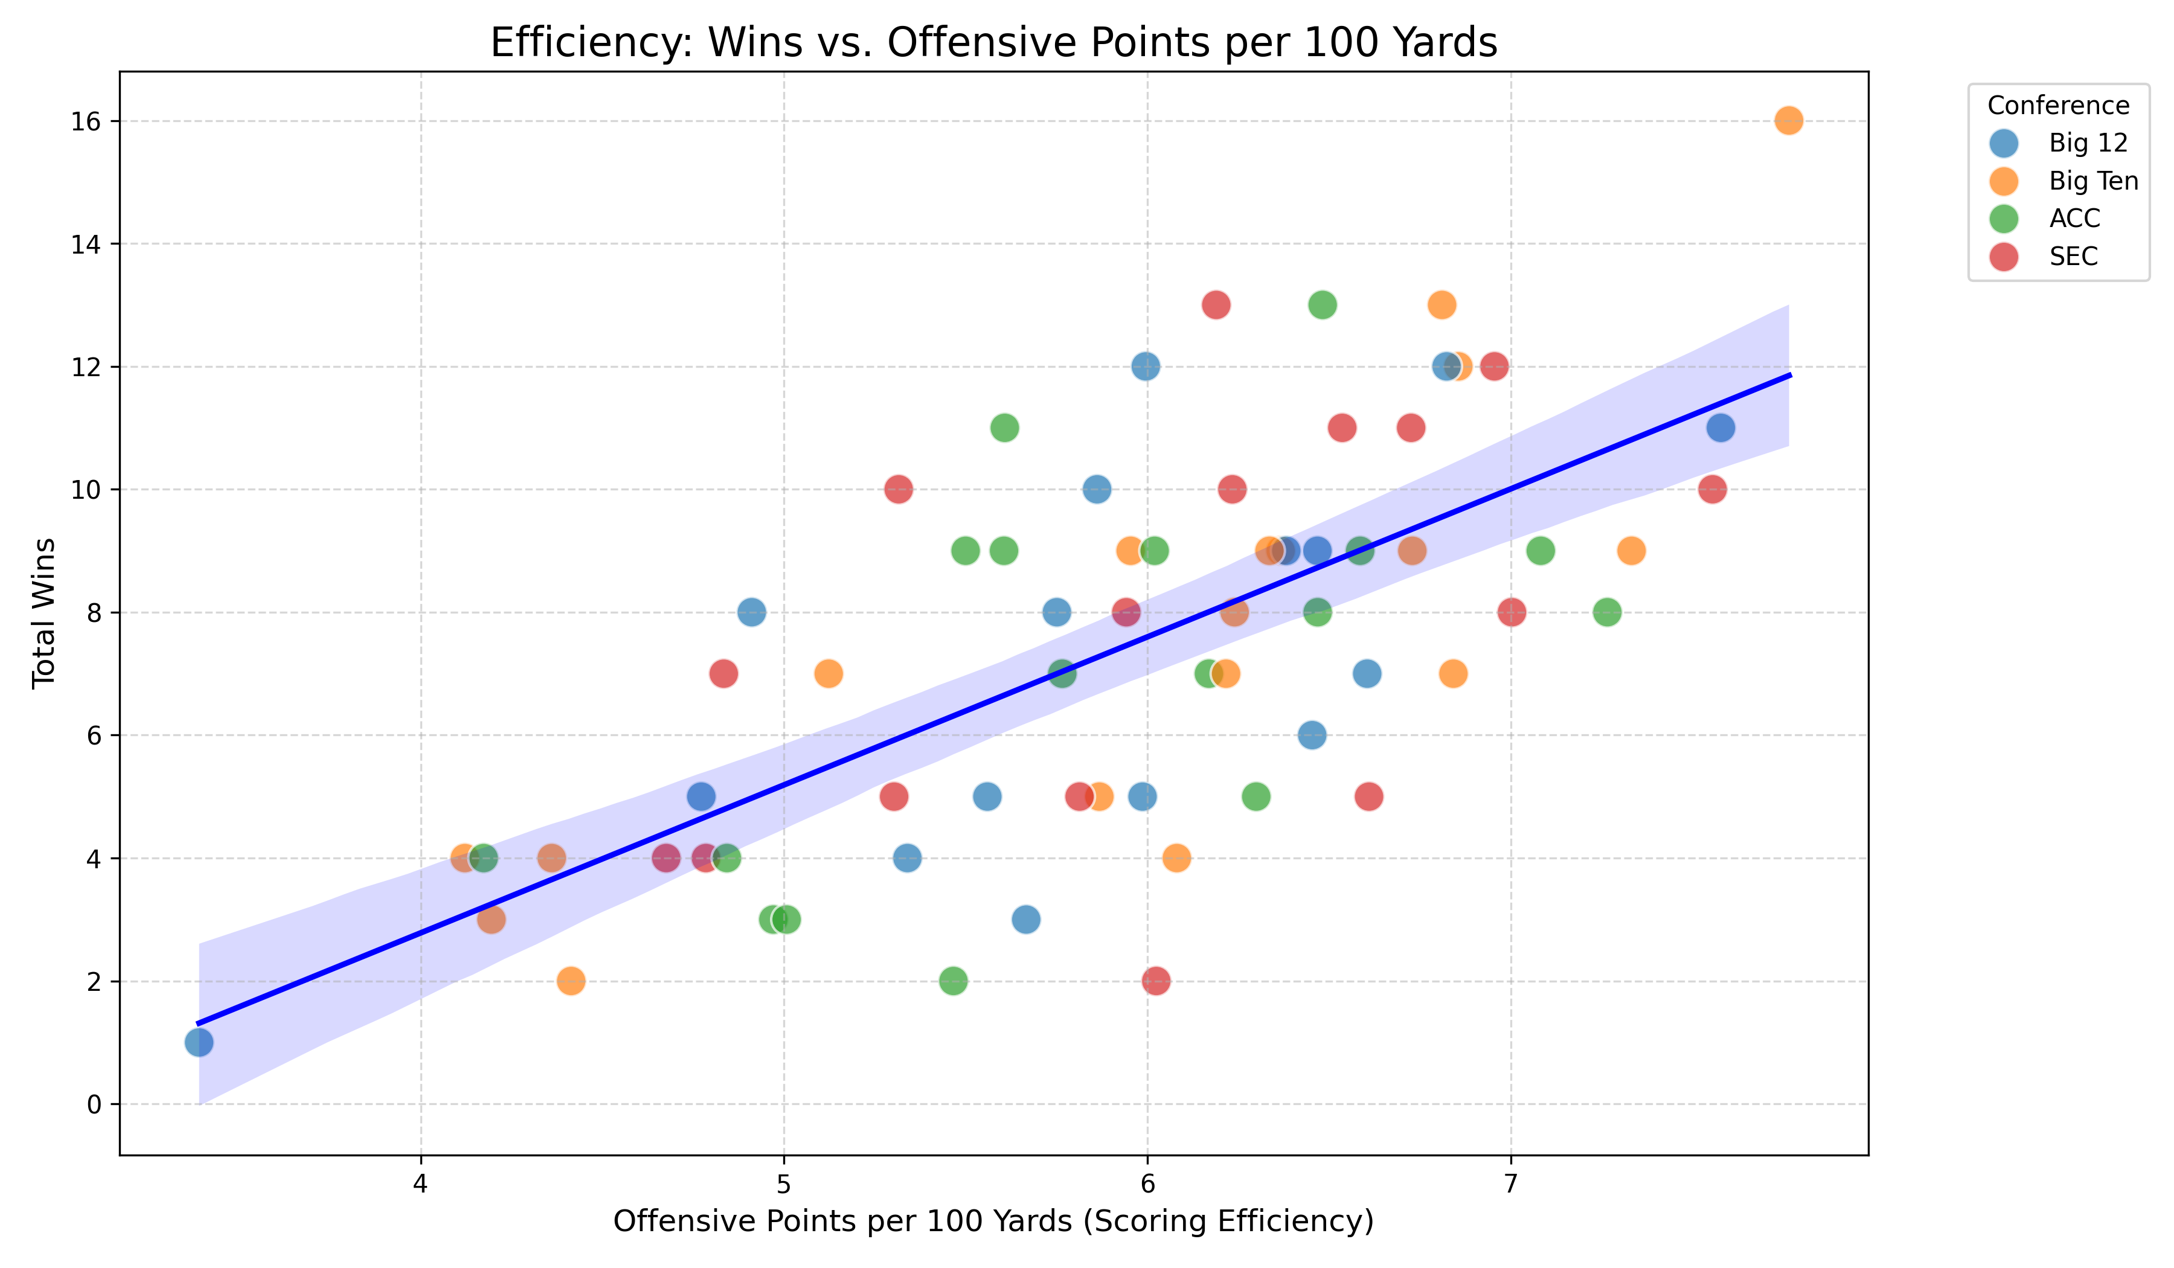
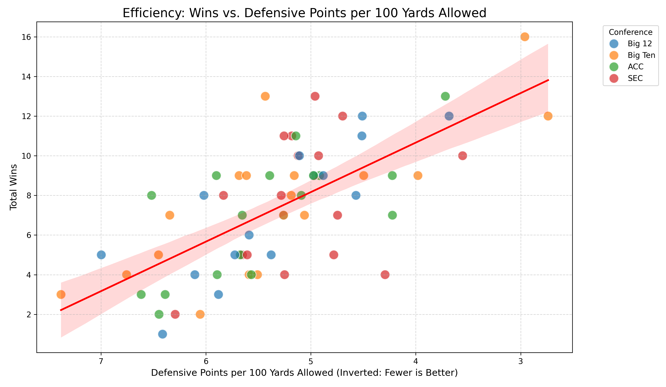
Conclusions
Scoring efficiency is more important than yards per game
Causing turnovers is slightly less important than giving up turnovers
All conferences averaged around 6 points per 100 yards of offense and gave up around 5 points per 100 yards on defense
Offense and defense are both extremely important when it comes to winning games, but defense is slightly more impactful when it comes to comparing wins and efficiency
Improvements to make: run analysis on redzone efficiency for both offense and defense to determine how well teams can score the ball inside the 20-yard line, run analysis on variables like weather and location to determine if running the ball or passing the ball more can affect overall efficiency and if so, by how much

